Slide 1


Book Recommendation System
Capstone Project
Presenter Name :
Vikas panchal
Naveen Kumar Batta

Slide 2
Content :
Intoduction
Problem statement
Data Summary
Analysis of different datasets
Data Cleaning
Outlier treatment
Imputing missing values
Different Recommendation Model
Challenges
Conclusion
Future Scope

Slide 3
Recommendation System
Recommendation systems produce a ranked list of items on which a user might be interested, in the context of his current choice of an item.
Subclass of Information filtering system that seek to predict the ‘rating’ or ‘preference’ that a user would give to them.
Applied in variety of applications like movies, books, research articles.
Recommendation systems involve predicting user preferences for unseen items • such as movies, songs or books
Recommendation systems have become very popular with the increasing availability of millions of products online
Recommending relevant products increases the sales
.

Slide 4
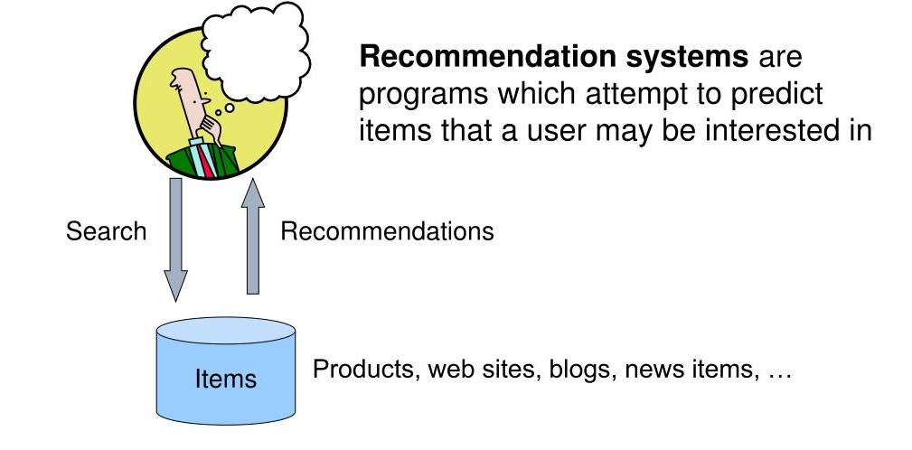
What is Recommendation System

Slide 5

Problem Statement
During the last few decades, with the rise of YouTube, Amazon, Netflix, and many other such web services, recommender systems have become much more important in our lives in terms of providing highly personalized and
relevant content.
The main objective is to create a recommendation system to recommend relevant books to users based on popularity and user interests.

Slide 6
Data Summary :-
The dataset is comprised of three csv files:: User_df, Books_df, Ratings_df
Users dataset.
● User ID (unique for each user)
● Location (contains city, state and country separated by commas)
● Age Shape of Dataset --(278858,3)
Books dataset.
● ISBN (unique for each book)
● Book Title
● Book Author
● Year Of Publication
● Publisher
● Image URL S
● Image URL M
● Image URL L
● Shape of Dataset --(271360,
Ratings dataset.
● User ID
● ISBN
● Book Rating
● Shape of Dataset --(1149780,

Slide 7
Data Cleaning :-
1. Find the Null Value Imputation:
Age column has 40% missing values
Look for missing data in user dataset

Slide 8
Data Cleaning Checking Outliers (Missing values)
Outliers in Age column
Age has positive Skewness (right tail) so we can use median to fill Nan values,

Slide 9
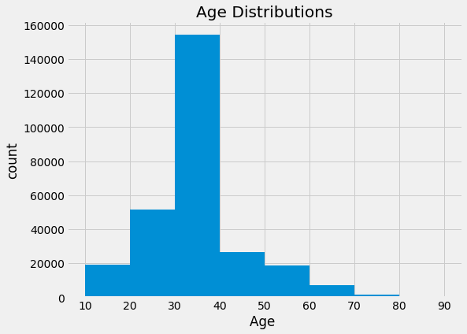
Observations from Users_df (Age)
The Age range distribution is right skewed
Most active readers lie in age group 20-40

Slide 10
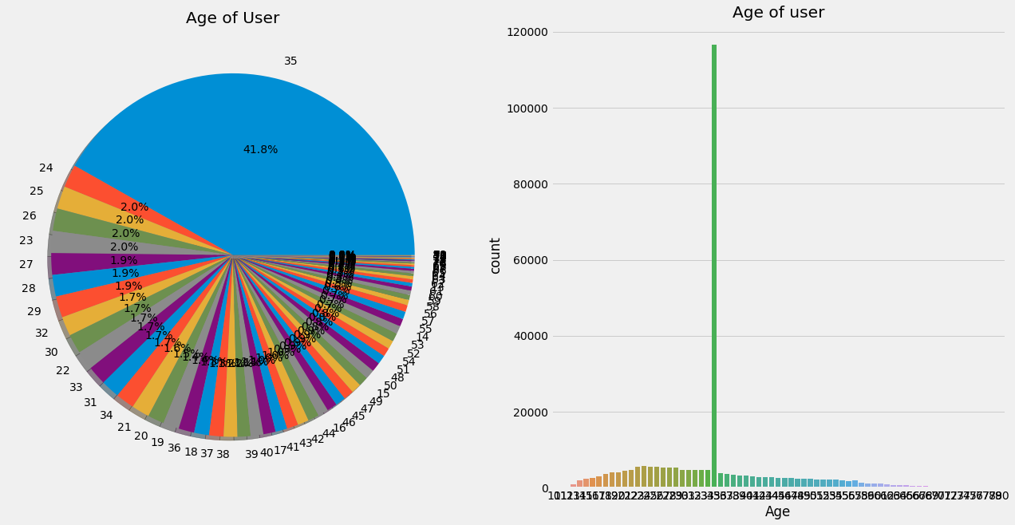
Observation Age of Users (countplot and pie chart):
From above plots we observed that 41.9% of age 34 group read more books compared to other age groups. Also the users with the age 60 and above do not read more books.

Slide 11
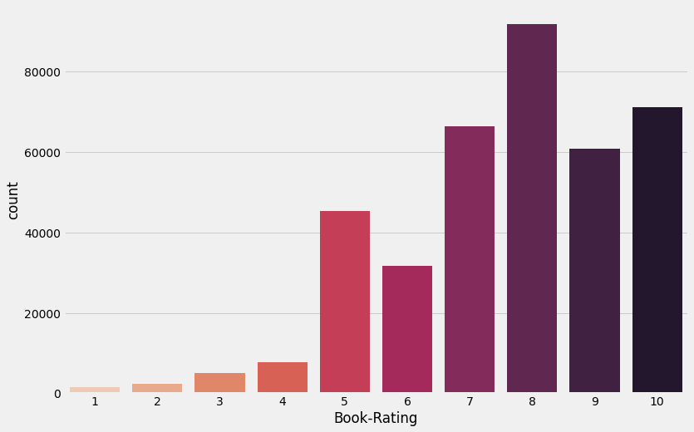
Book Ratings Count:
It can be observe that higher ratings are more common amongst users and rating 8 has been rated highest number of times
Higher ratings are more common amongst users

Slide 12
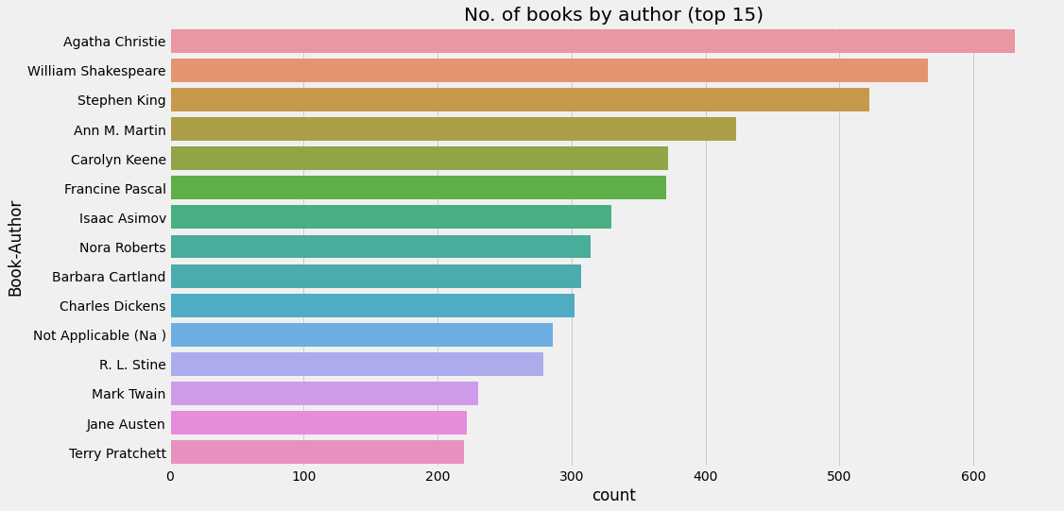
top 15 book authors based on their book count
Agatha christie are highest number of books write in our given dataset

Slide 13
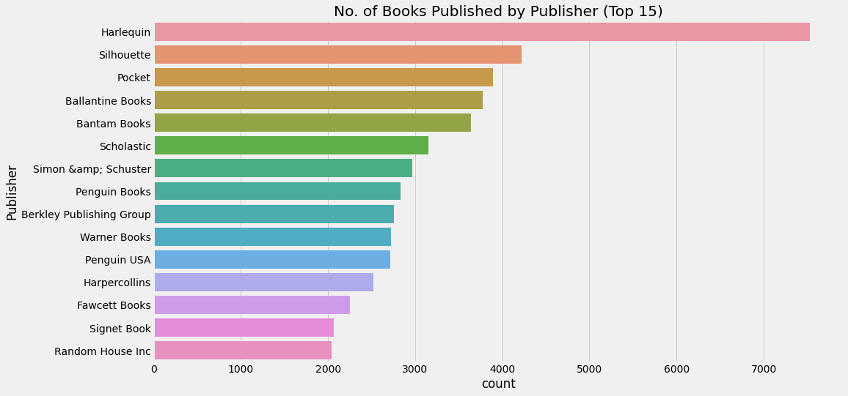
Top 15 Publishers based on their books Published
Harlequin published highest number of books in our given dataset

Slide 14
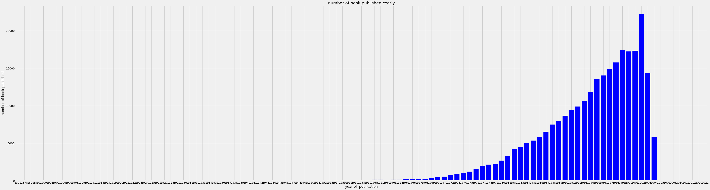
Number of book published by year count:
So we can observe that publication years are somewhat between 1950 - 2005 here.

Slide 15
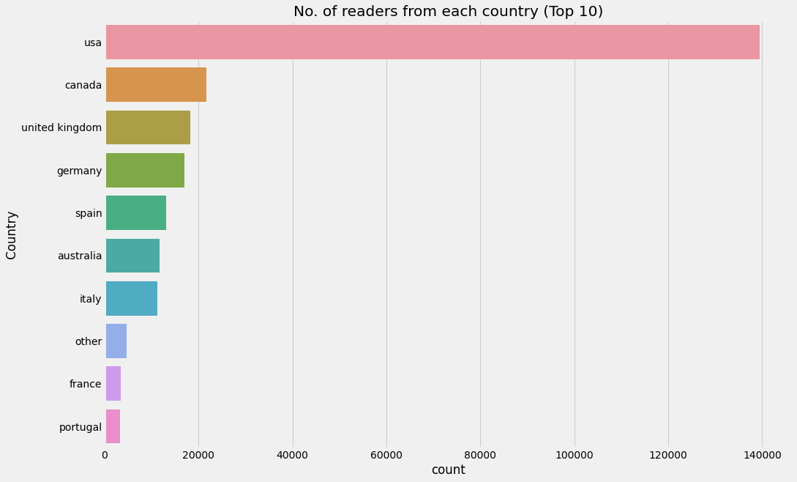
Top 10 countries based on number of readers :
Splitting Location column and analyzing country.
Most active readers are from USA.

Slide 16
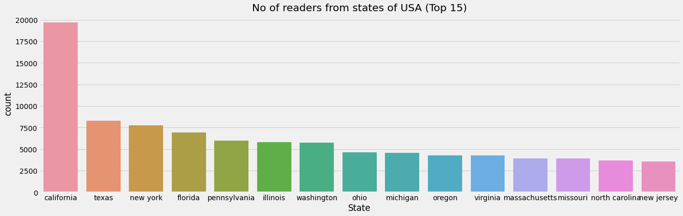
Top 15 readers from states of USA :
Splitting Location column and analyzing State of USA.
Most active readers are from California

Slide 17
Technology Used
python
Google
Colab
Numpy
Pandas
seaborn
Metplotlib
Flask

Slide 18
Model’s Performed
Popularity Based Recommendation
Recommend the top rating books
Collaborative
Recommend items those are preferred by similar users Content-based
Collaborative Filtering-(Item-Item based)
Collaborative Filtering-(User-Item based)
Content-based
Recommend items based on similarity between items and user's preferences Hybrid
Hybrid
Combines both

Slide 19
Popularity Based Recommendation
The popularity index used for our books dataset was weighted rating. The formula for weighted rating is:
WR = [(v * R)/(v + m)] + [(m * c)/(v + m)]
Where,
WR is weighted rating;
v is the number of votes for the books;
m is the minimum votes required to be listed in the chart;
R is the average rating of the book; and
C is the mean vote across the whole report.

Slide 20
Collaborative Filtering - (Item-Item based)
index | Book-Title | num_ratings | avg_ratings
80433 | Harry Potter and the Prisoner of Azkaban (Book 3) | 428 | 5.852803738317757
80421 | Harry Potter and the Goblet of Fire (Book 4) | 387 | 5.8242894056847545
80440 | Harry Potter and the Sorcerer's Stone (Book 1) | 278 | 5.737410071942446
80425 | Harry Potter and the Order of the Phoenix (Book 5) | 347 | 5.501440922190202
80413 | Harry Potter and the Chamber of Secrets (Book 2) | 556 | 5.183453237410072

Slide 21
Collaborative Filtering-(User Item based)

Slide 22
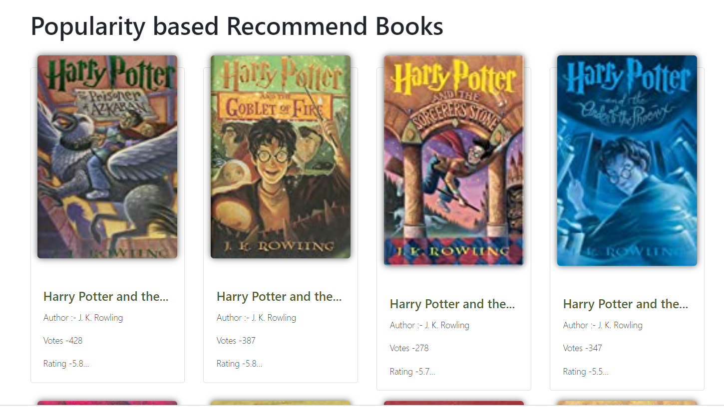
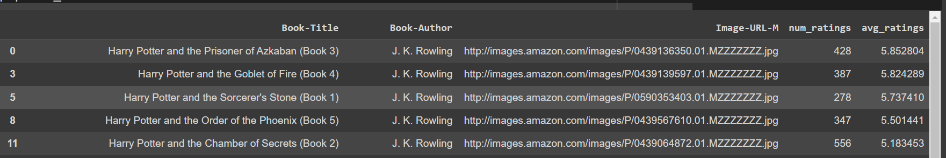
Popularity Based Recommendation
(user Interface)

Slide 23
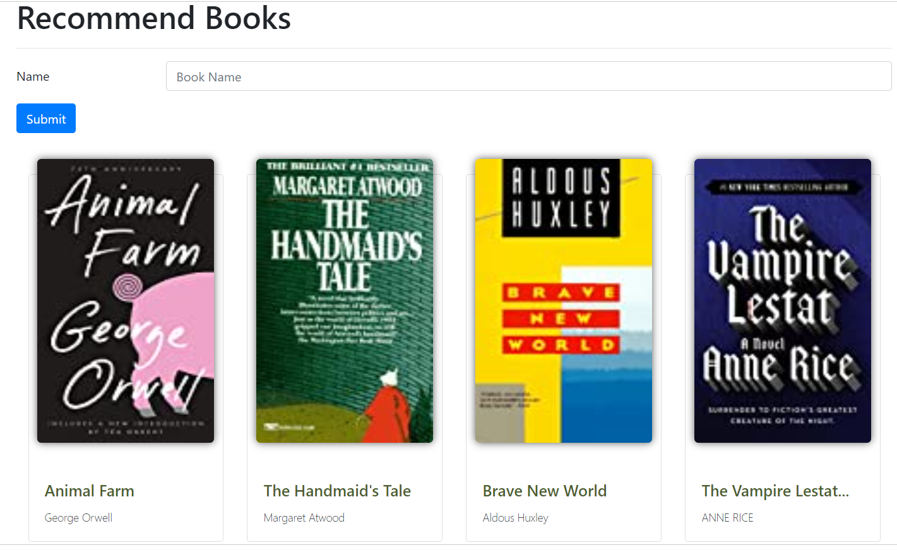
Collaborative Filtering(User Interface): Snapshot

Slide 24
Conclusion:
In EDA, the Top 10 most rated books were essentially novels Books like The Lovely Bone and The Secret Life of Bees were very well perceived
Majority of the readers were of the age bracket 20 35 and most of them came from North American and European countries namely USA, Canada, UK, Germany and Spain
If we look at the ratings distribution, most of the books have high ratings with maximum books being rated 8 Ratings below 5 are few in number
Author with the most books was Agatha Christie, William Shakespeare and Stephen King
For modelling, it was observed that for model based collaborative filtering SVD technique worked way better than NMF with lower Mean Absolute Error (MAE)

Slide 25
Future Scope:
Given more information regarding the books dataset, namely features like Genre, Description etc, we could implement a content filtering based recommendation system and compare the results with the existing collaborative filtering based system
We would like to explore various clustering approaches for clustering the users based on Age, Location etc. and then implement voting algorithms to recommend items to the user depending on the cluster into which it belongs

Slide 26

Challenges :
Handling of sparsity was a major challenge as well since the user interactions were not present for the majority of the books.
Understanding the metric for evaluation was a challenge as well.
Since the data consisted of text data, data cleaning was a major challenge in features like Location etc.
Decision making on missing value imputations and outlier treatment was quite challenging as well.

Slide 27




Thank you

